Slide 1
SQL Basics
Pradnya Dabhade

Slide 2
What is SQL
SQL stands for Structured Query Language
SQL lets you access and manipulate databases
SQL lets you perform CRUD operations on databases
C – Create
R – Read
U – Update
D - Delete

Slide 3
What is a database example
School Data
Student Data
Name
Daily attendance
contact
Student Marks
Math marks
English marks
….
DBMS – DataBase Management System
MySQL
PostgresSQL
SQL Lite (Python)

Slide 4
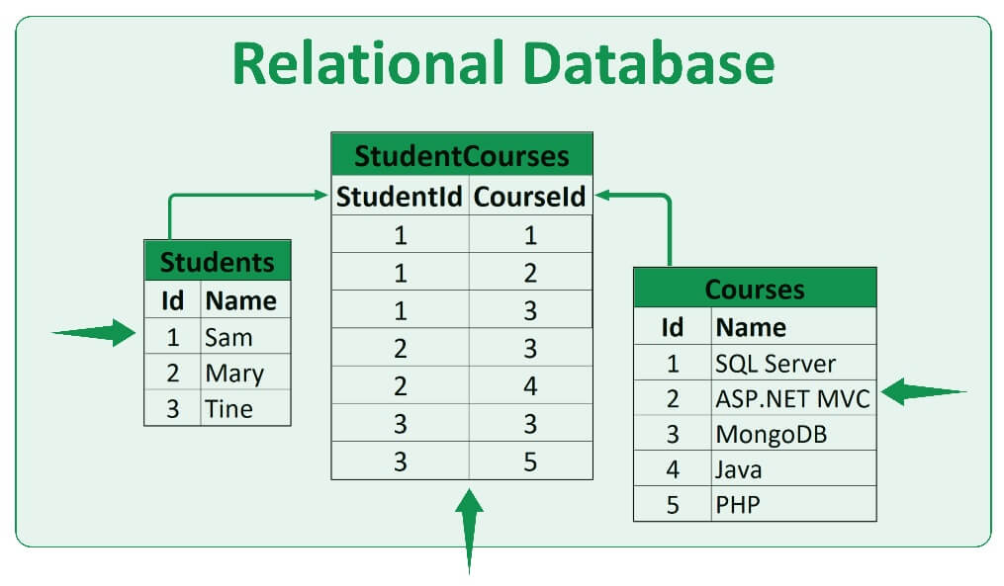
What is relational database (SQL Database)
noSQL (Non-Relational Database) : MongoDB

Slide 5
Database
Tables
Column and rows

Slide 6
DBMS Softwares
DataBase Management System (DBMS)
PostgreSQL
MySQL
SQLlite

Slide 7
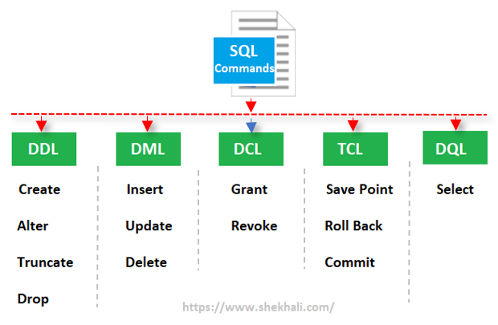
Different types of SQL Queries
Data Manipulation Language
Data Definition Language
Transactional Control Language

Slide 8
Structure of SQL Databases
Database file .db
Tables
Columns

Slide 9
Why to use SQL instead of excel
SQL Capable of Handling Data upto 16 TB
SQL has effective collaboration
SQL is faster than excel
SQL is more secure compared to excel
UserID | name | age | email | mob
1 | Utkarsh | 28 | utkarsh.etlhive@gmail.com | 12312412
 | Raman |  |  | 1241254
4 | Aditi | 16 | test@test.com | 12312412
4 | Karan | 22 | test2@test.com | 1242143125

Slide 10
Thank You
You can ask me queries by tagging me on this skype group

